Slide 1
SharePoint 2010 Site Collections & Sites

Slide 2
Agenda
Site Collection Logical Layout
Concepts of Hierarchy
Understanding URL’s
A Tour of Site Settings

Slide 3
What is a Site Collection?
A collection of related SharePoint sites
A component of a SharePoint web application
Begins with a Top Level Site
Hierarchical relationships offer inheritance
Provides global objects via galleries
Managed by a Site Collection Administrator
Notes:
One fundamental and often a most difficult concept for site administrators and site collection administrators to understand is the logical architecture of SharePoint site collections. But the structure of SharePoint site collections is key to knowing how sites and their available content will behave during user interaction. In simplest terms, a SharePoint site collection is a collection of one or more SharePoint sites that are deemed as being related by their creators. But what do we mean by related? Depending on the taxonomy or governance design of your SharePoint enterprise the term can encompass sites that will:
Contain data that is sought and/or utilized together by information workers
Require the same personnel to be responsible for administration
Employ similar Features, templates, stylization, site columns or content types
SharePoint manages site collections as a single cohesive unit, even though they are comprised of multiple sites. In doing so, SharePoint can create a place for each site collection in the logical architecture of its programming code. In code, site collections are definable objects created within the boundaries of a SharePoint web application. Web applications are created and managed by server administrators and dictate things like the authentication provider and TCP port number that will be utilized by all site collections created therein.
Site collections organize their sites into a hierarchy that begins with the first site ever created into the collection. This first site, called a Top Level Site, bears the URL that will persist through all additional sites added to the collection. Also, its galleries (highly sophisticated libraries) contain items that can be made available to the other sites in the collection, and it is the source of the security architecture’s inheritance stream. Galleries and security are discussed later in this course. Each site collection is managed by named Site Collection Administrators.

Slide 4
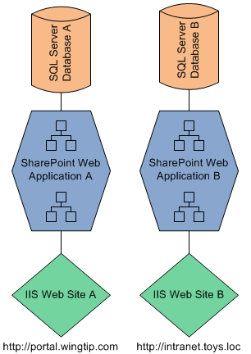
Web Application Primer
1:1 initial relationship to a storage database in SQL
1:1 initial relationship to a web site object in IIS
House one or more site collections, each associated with an individual URL namespace
Notes:
Without getting too lofty in our discussion about site collections, a general understanding of SharePoint web applications and how they relate to other technologies that support SharePoint might help you plan and manage your site collections.
As you can see in the drawing above, a SharePoint web application has a direct correlation to objects in two other supporting Microsoft applications: Internet Information Services (IIS) and SQL Server (SQL). And though these server applications will likely be managed by server administrators, your actions as a site collection administrator can have consequences that reverberate through these other two technologies as well. Similarly, actions taken by the IIS Administrator and SQL Administrator can have repercussions on your site collections.
Each web application created by your SharePoint server administrator will be exposed to the world through one or more “web site” objects in IIS. The IIS administrators can use the configuration settings on the IIS web site to configure size limits, access security, and all kinds of functionality. Also, each web application will store its SharePoint configuration settings as well as the site content for all of its site collections in an associated database in SQL Server. SQL Administrators can configure these databases for size limits, security, recovery and availability to work in conjunction with the policies mandated by your SharePoint server administrator.

Slide 5
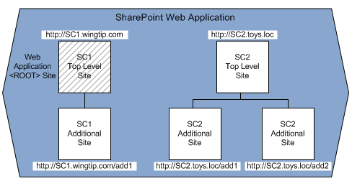
Site Collections in Web Applications
A Web Application is devoid of content until the 1st Site Collection is created containing at least a Top Level Site
A Web Application can house multiple Site Collections
The Top Level Site of the 1st Site Collection becomes the <ROOT> site of the Web Application
Notes:
As previously mentioned, site collections are created as a component of a given web application, which dictates specific configuration settings to its site collections. Without any site collections, a web application has logical presence in SharePoint’s code but offers no web pages for users to visit and no SharePoint sites for users to store their data.
The Top Level Site of the first site collection created into a web application is referred to as the <ROOT> site of the web application and is usually created by the SharePoint server administrator during web application creation. However, personnel other than the server administrator can be named as Site Collection Administrator and/or Site Administrator to the <ROOT> site later. The <ROOT> site of a web application is very important, any site or site collection administrator should always check with the SharePoint server administrator before dismantling a <ROOT> Top Level Site. Deleting a <ROOT> site of a web application inadvertently can have detrimental effects on the web application as a whole and thus all of its remaining site collections.
Each site collection added to a web application will begin with its very own Top Level Site. For some small SharePoint enterprises, this single site may be enough and they will not create any additional sites into the site collection. Others may need additional sites that will be created into the collection in a hierarchical fashion.

Slide 6
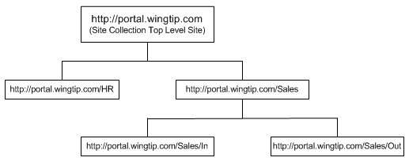
Sites in Site Collections
Parent
Child
Parent
Child
http://portal.wingtip.com is a parent to both HR and Sales
http://portal.wingtip.com/HR is a child of the Top Level Site
http://portal.wingtip.com/Sales is a child of the Top Level Site
http://portal.wingtip.com/Sales is a parent to both In and Out
Notes:
Once a site collection has been started by creating its Top Level Site and assigning specific personnel as Site Collection Administrators, additional sites that will relate to one another as well as to the existing Top Level Site can be added to the collection. These additional sites can be created by the named site collection administrators or by any user who has been granted the necessary Create Subsites and Workspaces permission on the Top Level Site itself.
Site collections organize their sites in a familial hierarchy referred to as Parent to Child. Essentially, before a site can be added to the collection one of the existing sites in the collection must be selected to be the new site’s “parent”. Choosing which existing site in the collection will become the new site’s “parent” is a delicate decision because the new site will receive all of its security inheritance, navigation inheritance and global object inheritance from its “parent” site. Also, the procedure for moving a site within a site collection (or to another site collection) is a complex operation that must be performed by a SharePoint server administrator. So plan carefully before creating new sites.
When a site collection is new and only consists of the Top Level Site there are not multiple choices to become the “parent” of a new site. The second site built into a site collection will always use the Top Level Site as its “parent” and become a “child” of that Top Level Site.
Each layer of sites in the collection represents a level, or tier, of the site collection. Sometimes, administrators will refer to sites located in the same tier as “siblings” (probably because they share the same parent site), but this is not an official technology term. Similarly, it would be inappropriate to refer to the Top Level Site as a “grandparent” of a site at the second tier beneath the Top Level (a Top Level child site’s child). Still, sometimes such family descriptions can help you visualize where a site falls in the site collection hierarchy when you don’t have access to a site collection diagram.
However, once a collection consists of multiple sites then site collection design plays a key role in the creation of additional sites into the hierarchy. The Top Level Site can have multiple child sites underneath it, and each of those child sites can become a parent itself and have one or more child sites underneath it. Some SharePoint enterprises may produce a Governance or Standards document that dictates the preferred hierarchical structure of its site collections. Yet other enterprises may have formal change control measures in place to approve all changes to site collections and their hierarchies.

Slide 7
DEMO
Introducing SharePoint Site Collections
Notes:
In this demonstration, your instructor will navigate around a live Site Collection, describing site placement.

Slide 8
Agenda
Site Collection Logical Layout
Concepts of Hierarchy
Understanding URL’s
A Tour of Site Settings

Slide 9
Concepts of Hierarchy
Direct Links
Branching
Path
Nested Hierarchies
Inheritance
Notes:
SharePoint is based on Microsoft .NET programming languages and uses hierarchical structure organization throughout its code to organize objects (not just site collections). Therefore, some core concepts you must understand about SharePoint hierarchies in order to use them to your advantage and avoid undue administration include:
Direct Links: entities in the hierarchy have direct links only to the entity “above” them (parent) and the entity “below” them (child)
Path: direct links between a parent entity and a child entity can be followed from entity to entity to navigate up and down; by following links up the hierarchy to a parent then down to another child navigation can also occur across the hierarchy
Branching: each parent entity can have multiple child entities underneath, some child types can have children of their own (such as folders in a library), some cannot (such as an individual document item in a library)
Nested Hierarchies: a parent with multiple children constitutes a nested hierarchy within the overall hierarchy
Inheritance: children entities inherit their parent entity’s properties and objects by default
SharePoint sites, pages, lists, libraries, folders and items within are all organized into hierarchies that benefit from these characteristics.

Slide 10
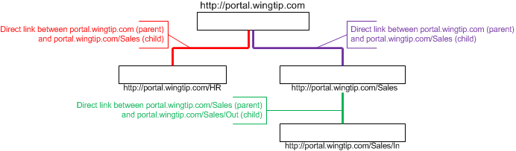
Direct Links
Connection between a parent and a child
Contribute to paths in the hierarchy
Support inheritance
Combine to offer indirect relationships
Notes:
Direct links are the relationships between a parent entity and its child entity. And while a single parent may have multiple children, each child receives its own unique direct link to the parent. This link provides namespace, inheritance, and a navigation gateway from the child to the parent and possibly entities above that parent in the hierarchy (of from the parent to the child and entities below that child in the hierarchy).
The link between a parent and its child can be supplemented by the link between that child, as a parent, and a child below it. When two or more links are added together they form a path between entities. SharePoint hierarchies allows all links to contribute to multiple paths, making navigation between indirect entities flexible and fault tolerant.
By default, SharePoint enforces inheritance via downward paths. This means things like URL namespace, permissions, users/groups, navigation tabs, cascading stylization, templates, and more that are present at the parent will be inherited by its children by default. Of course, administrators may choose to turn off this inheritance but, in doing so, create more administrative work because children with no inheritance must then be managed independently. More on disableing inheritance appears later in this course.
Direct links assure that all communication in the hierarchy takes place solely between a parent and its child. Though it is possible to navigate to entities outside the immediate parent to child relationship via paths, such communication is considered indirect because it must go through intermediary entities.

Slide 11
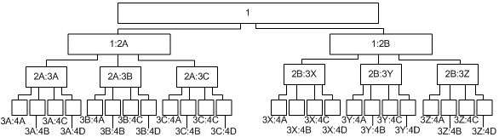
Branching
Notes:
Branching in SharePoint hierarchies allows a single parent entity to have more than one child. Branching hierarchies are what most of us think of when we visualize a hierarchy structure. In fact, some people even refer to branching hierarchies as pyramids, probably because they start with a single parent and often get wider as you go down the tiers with each child having multiple children themselves. When you outline such a structure vertically on paper, then draw a triangle around it, the triangle forms a pyramid shape.
Branching gives SharePoint administrators design flexibility and keeps administrative overhead low. If there are multiple sites that must all inherit the same properties they can be organized neatly under the same parent.
In a non-branching hierarchy each parent is limited to only a single child. This means separate parents with identical properties would need to be created for each child that should inherit the same settings, resulting in very wide tiers (when diagrammed vertically). The more parents necessary to duplicate the property settings, the more parents that must be managed and kept in sync with one another resulting in severe administration overhead. In a large enterprise such a limitation would prove overwhelming.

Slide 12
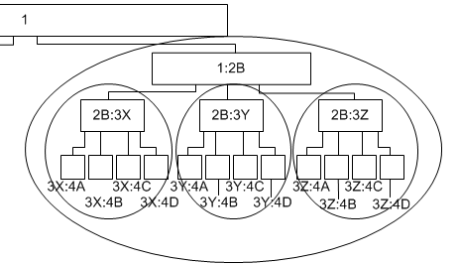
Nested Hierarchies
Nested hierarchies within a nested hierarchy
Notes:
Within a branching hierarchy, such as SharePoint, miniature hierarchies will emerge when an entity becomes a parent to multiple children. Because such a miniature hierarchy exists within an already established hierarchy it is said to be a nested hierarchy.
Nested hierarchies have the same behavioral characteristics of a true hierarchy (direct links, branching, paths, inheritance, etc.). In fact, if a SharePoint administrator decides to disable inheritance on the parent of the nested hierarchy and instead configures this entity with its own security settings, stylization, navigation tools and templates (just to name a few), then those new values will be inherited down within the nested hierarchy. In this manner, a nested hierarchy within SharePoint can become its own administrative boundary.

Slide 13
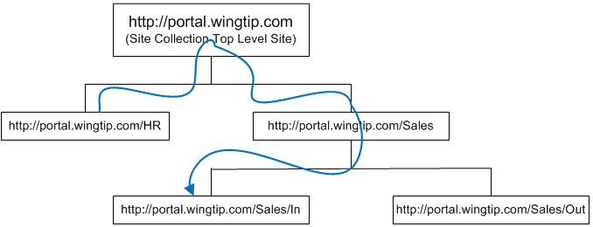
Paths
Use direct links as roadways from entity to entity to entity to entity…
Provide hierarchy-wide navigation and communication
Vulnerable to broken links
Notes:
Paths are constructed of multiple direct links that flow through the hierarchy to upstream or downstream neighboring entities. A branching hierarchy can contain many paths but each path is a unique and single avenue to a specific entity. If one of the links needed to follow the path gets corrupted, it may be impassable and navigation to the entity can become disabled.
In SharePoint, a broken path is not necessarily a mission critical failure. For example, in a site collection hierarchy such as the one above, if the path were interrupted it might still be possible to enter into the browser application’s URL field http://portal.wintip.com/Sales/In and arrive at the In site underneath Sales.
When a path is broken it does not mean that the data made available through the path’s destination has become corrupt or unavailable. It simply means that navigating to that destination from other entities in the hierarchy is temporarily out of service.

Slide 14
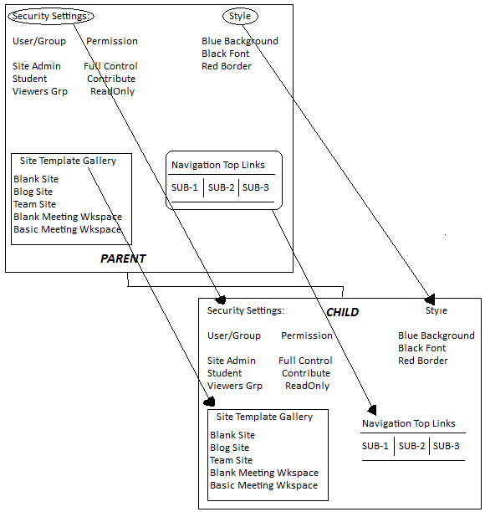
Inheritance
Notes:
Inheritance is by far the hierarchy behavior that will have the most impact on your efforts as a Site Collection Administrator or Site Administrator. By default, SharePoint invokes inheritance on all child entities created in a hierarchy. In a site collection, this means that a child site will, by default, inherit all possible inheritable properties of its parent site and have access to all global objects in its parent site (as depicted in the illustration above).
Of course, the administrator of the child site can choose to disable inheritance on any given property set, such as security permissions or navigation elements. Additionally, the administrator may choose not to employ any of the global objects from the parent site that are available as well in the galleries of the child site. As for style, a child site administrator may choose to override the cascading style elements being inherited from the parent site by employing a different style sheet or theme on their site.
However, disabling inheritance introduces additional administrative overhead to SharePoint and can cause inconsistencies in the environment, leading to decreased business information worker productivity. Inheritance should be considered an asset and used to your advantage by planning your SharePoint site collections, sites, pages, lists, libraries, folders and items from the “top down”. Also, inheritance should always be kept in mind when choosing content and object placement in a SharePoint enterprise. Will uploading a specific document to Library B on Site C introduce the need to disable permissions inheritance? Than perhaps Library B on Site C is not the best place for that document!

Slide 15
SharePoint Inheritance Hierarchy
Objects | Inherit From
Site | Parent Site in Site Collection
Web Page | Resident Site
List | Resident Site
Library | Resident Site
Folder | Resident List or Library
Item | Resident Folder or List or Library
Notes:
In SharePoint, many objects exist within a hierarchy and therefore experience inheritance. Sites exist within a site collection. Web pages, lists and libraries exist within a given site. Folders are products of a list or library. And list/library items are organized either into the root of the list/library or into one of the list’s/library’s folders.
For example, in the case of permissions inheritance, a given document organized into a folder within a particular library will inherit its permission settings from its folder, which inherits its permission settings from the library, which inherits its permissions settings from the site, which inherits its permission settings from its parent site, which inherits its permission settings from its parent site, who inherits permissions from its parent, and up the site collection direct links we go until we reach the top level site.
So you can see that in a “from the top down” strategy, the permission settings defined at the top level site of the site collection will influence not only all of the pages, lists, libraries and items within the top level site but also all of the pages, lists, libraries and items in all of the sites throughout the entire collection!

Slide 16
DEMO
Exploring the Site Collection Hierarchies
Notes:
In this class discussion led by the instructor, you will diagram the hierarchy of an existing SharePoint site collection.

Slide 17
Agenda
Site Collection Logical Layout
Concepts of Hierarchy
Understanding URL’s
A Tour of Site Settings

Slide 18
Understanding URL’s
Uniform Resource Locator
Universal Resource Locator
Web Address
Fully Qualified Internet Domain Name (FQDN)
DNS
Web site vs. page
More than just a name
Notes:
Today’s Internet age has exposed many of us to URL’s, otherwise known as Uniform Resource Locators (or Universal Resource Locators). These are the web addresses we type into the destination fields of our favorite web browser application to visit web sites on the Internet or on our corporate Intranet. URL’s take advantage of the Domain Name System, DNS, which is the namespace architecture of many directory systems such as Microsoft Active Directory, SharePoint and even the Internet itself. DNS uses hierarchical namespaces to breakdown massive groups of resources and URL’s call for resources that have been registered into those namespaces. In DNS, the complete name of a resource (or FQDN) includes the resource’s hostname as well as the name of the resource’s resident namespace and the names of all upstream namespaces all of the way up to the root of the directory (the root can be represented by a trailing period on the end of the name).
Internet and Intranet web sites, including SharePoint sites, are actually compilations of multiple web pages and cannot be rendered in their entirety within a single web browser application window. If you enter a web site’s URL into your web browser, the web page from the site that has been marked by the site administrator as the default web page for the site will be the page to appear in the browser the web page from the site that has been marked by the site administrator as the default web page for the site will be the page to appear. However, if you enter a web site’s URL followed by a forward slash “/” (URL’s recognize forward slashes as delimiters or separators) and end the URL with the name of a specific web page file, such as welcome.aspx, then the page you specify is the page from the site that will appear in the browser.
But URL’s do more than simply tell the browser where to go and what web page to pull back. They can include additional information beyond site and page names such as filter criteria, data queries and complex search instructions. However these additional capabilities can be considered security risks and therefore must be deliberately supported on the site by the site administrator.
In SharePoint, EVERYTHING has a URL! From each SharePoint site to each list, folder, and individual item within that list. Every picture you upload to a picture library has its own URL. Every list settings page or Site Actions menu hyperlink destination has its own URL. Using these powerful resource names a user with adequate permission can point their browser or Office application directly to a single item from a list without navigating to the resident SharePoint site first.

Slide 19
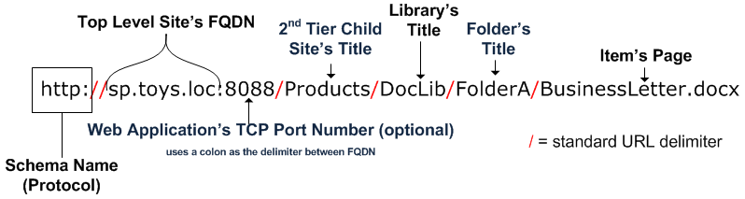
Dissecting a URL
Notes:
SharePoint URL’s consist of the following components:
Schema Name (Protocol) – Identifies namespace being requested and dictates syntax for remainder of the URL
Delimiters – divide sections of the URL syntax, standards for HTTP syntax include colons and forward slashes
DNS name or IP Address – registered name or IP address of the web site on a hosting web server
Sub-Site Title – text value entered into the URL field during site creation
Container Title – text value entered into the Title field during list or library creation
Sub-Container Title – text value entered into the Name field during folder creation
Item – file or web page of the individual list or library item

Slide 20
Agenda
Site Collection Logical Layout
Concepts of Hierarchy
Understanding URL’s
A Tour of Site Settings

Slide 21
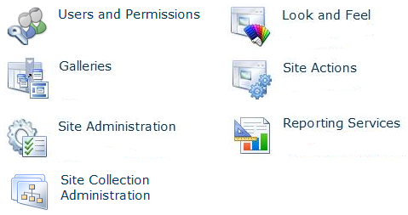
Site Settings
Notes:
The default master page of SharePoint sites includes a Site Actions menu that allows users who have the required authority to edit and manage SharePoint sites and their content. One of the links in the Site Actions drop-down menu called Site Settings leads to a web page that contains links to several utilities which will assist both Site Administrators and Site Collection Administrators in maintaining and managing the site. On a Team Site, the Site Settings page is divided into the following categories:

Slide 22
DEMO
Exploring Site Settings
Notes:
In this demonstration the instructor will introduce each of the tools found in Site Settings on a SharePoint Team Site.

Slide 23
Summary
Site Collection Logical Layout
Concepts of Hierarchy
Understanding URL’s
A Tour of Site Settings

